Slide 1
P2 Intro:
MCTS for Ultimate Tic Tac Toe

Slide 2
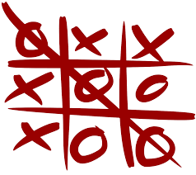
What is Ultimate Tic Tac Toe?
Tic Tac Toe:

Slide 3
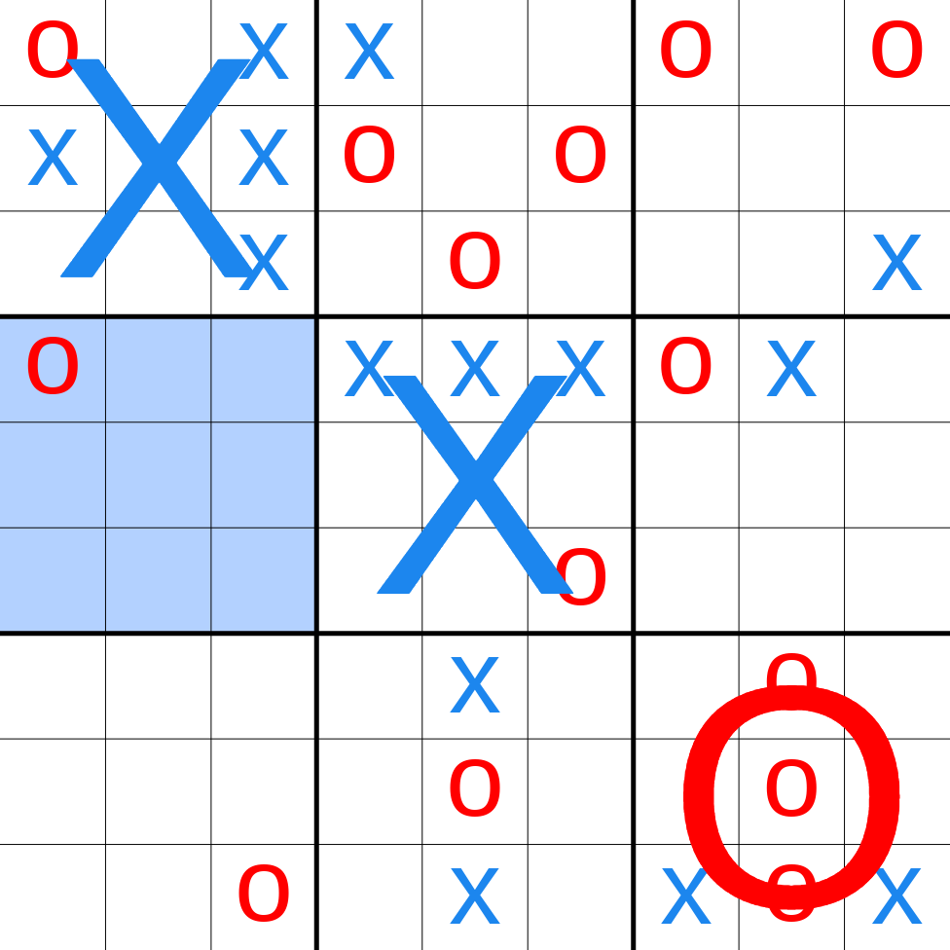
What is Ultimate Tic Tac Toe?
Ultimate Tic Tac Toe:

Slide 4
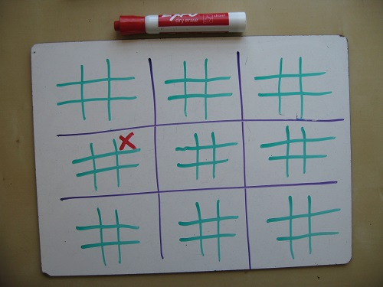
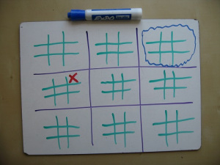
What is Ultimate Tic Tac Toe?
How to move:

Slide 5
The Programming Assignment
1. Implement basic MCTS bot (4 pts)
2. Implement modified MCTS bot (2 pts)
(refer to lecture and suggestions in .docx instructions)
3. Evaluate differences between your bots (4 pts)
4. (Extra credit) Do 3 again, using time rather than size of MC tree as constraint (# of pts TBD)

Slide 6
Provided files
p2_play.py: Interactive command-line player.
“python p2_play.py human human” for human v human play
“python p2_play.py human rollout_bot” for human v robot play
Generally: “python p2_play.py P1 P2”
p2_sim.py: Multi-game simulator with minimal output
E.g., “python p2_sim.py random_bot rollout_bot”
Generally: “python p2_sim.py P1 P2”
Note: Adding new bots to these scripts requires modifying the ‘players’ dictionary they define.
p2_t3.py: Core simulation functions and Board class for ultimate tic-tac-toe. © 2014 Jeff Bradberry.

Slide 7
Provided files
Sample bots:
random_bot.py: Picks and plays a random action.
rollout_bot.py: Picks and plays the action which, on average, tends to lead to the best outcome in random rollouts.
Bots all define a think(board, state) function which returns an action.
You can ask the board for the legal actions in a state: board.legal_actions(state)
And you can ask the board for the next state after applying an action: board.next_state(state, action)

Slide 8
You code these files
mcts_node.py: Utility class for MCTS nodes
mcts_vanilla.py: Basic MCTS implementation
mcts_modified.py: Modified/enhanced MCTS implementation

Slide 9
How to start (1)
run p2_play.py a couple times with one or both human players, understand how p2_t3.py implements ultimate tic-tac-toe
run p2_play.py with bots, understand how the two provided bots work
run p2_sim.py with bots, understand how p2_sim.py works

Slide 10
How to start (2)
implement MCTS bot
States are immutable tuples
Understand what “leaf nodes” are

Slide 11
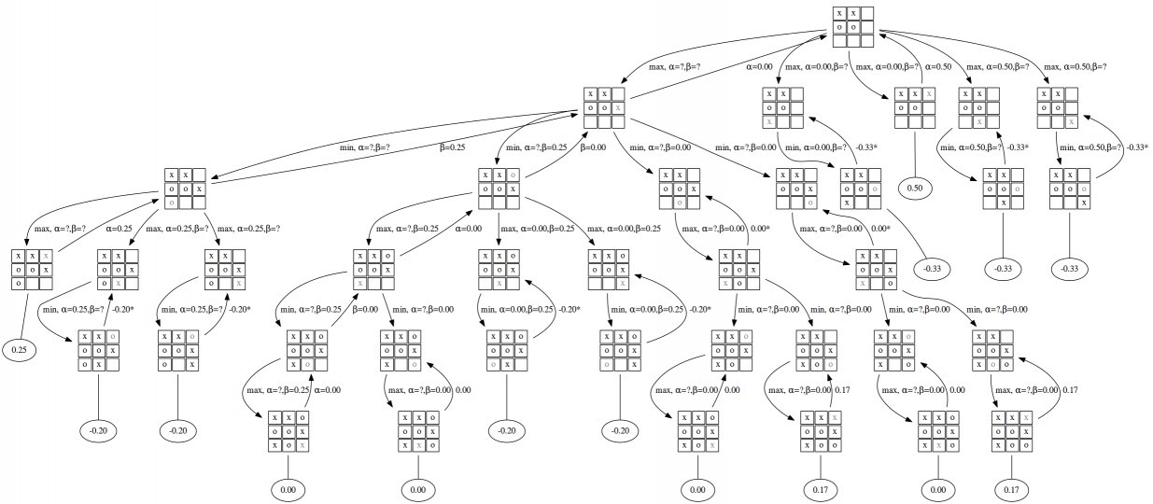
Example image w/ regular tic tac toe

Slide 12
How to start (2)
implement MCTS bot
States are immutable tuples
Understand what “leaf nodes” are
Backpropagate recursively
def backpropagate(node, score):
#if node is root return
#do update stats in node
backpropagate(node.parent, score)

Slide 13
How to start (3)
make sure the MCTS bot beats the random and random rollout bots
implement the modified MCTS bot
Run the evaluations
(Optional) run the extra credit evaluations

Slide 14
Questions

